Slide 1


Module 1 : Final Project
By: Payam Abbasi
04/27/2020

Slide 2
The Deliverables
Jupyter Notebook √
README.md file √
PowerPoint Slides √
A Blog Post √

Slide 3






Problem Statement
Comedy?
Drama?
Action?
What type of films are currently doing the best at the box office?
Horror?
Animation?

Slide 4

Business Value
Better understanding of the film industry
&
Profitability

Slide 5


The Dataset

Slide 6
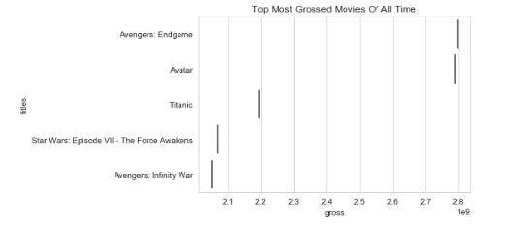





Top 5 Grossing movies of all time
2019 : PG-13
2009 : PG-13
1997 : PG-13
2015 : PG-13
2018 : PG-13
$2,797,800,564
$2,787,965,087
$2,186,772,302
$2,066,960,090
$2,048,359,754

Slide 7

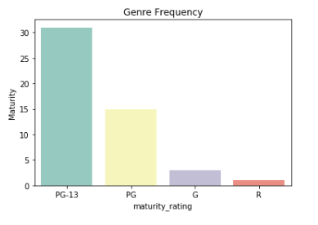



What maturity rating is the most watched?
√

Slide 8

Why Rated PG-13?
Young
Men
Old
Female

Slide 9
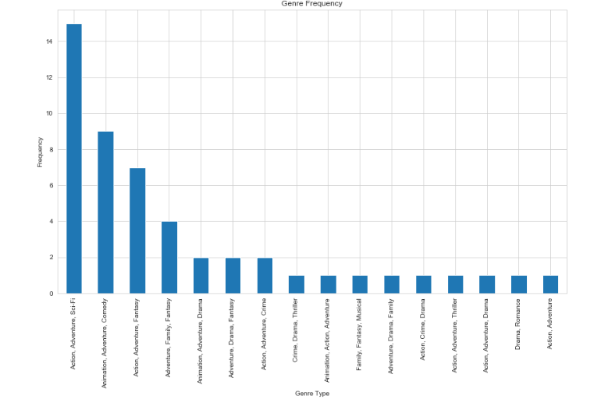
What genres do most people enjoy watching?

Slide 10
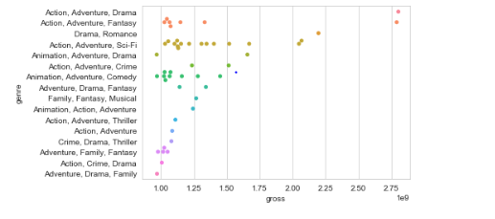
What genres Bring the most money?

Slide 11

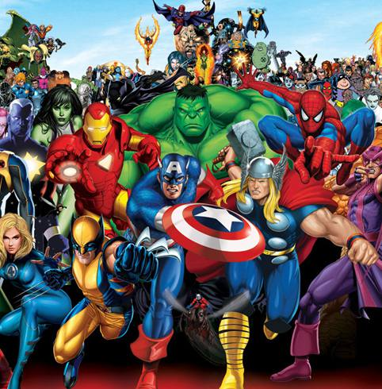
$$$ Why Action & Adventure? $$$
Keeps you on the edge!
We want to be them!

Slide 12
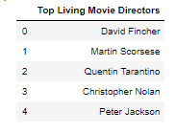
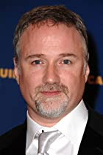



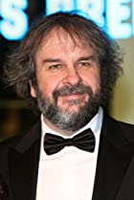
Top 5 Living Directors

Slide 13
Maturity Rating PG-13 Genre Adventure/Action top 5 directors 1. David Fincher 2. Martin Scorses 3. Quentin Tarantino 4. Christopher Nolan 5. Peter Jackson
What to invest on?

Slide 14

Future Work
Budget Vs. Profit
Top Grossing Living Actors and Actresses
Streaming?

Slide 15

Any questions?

